Slide 1
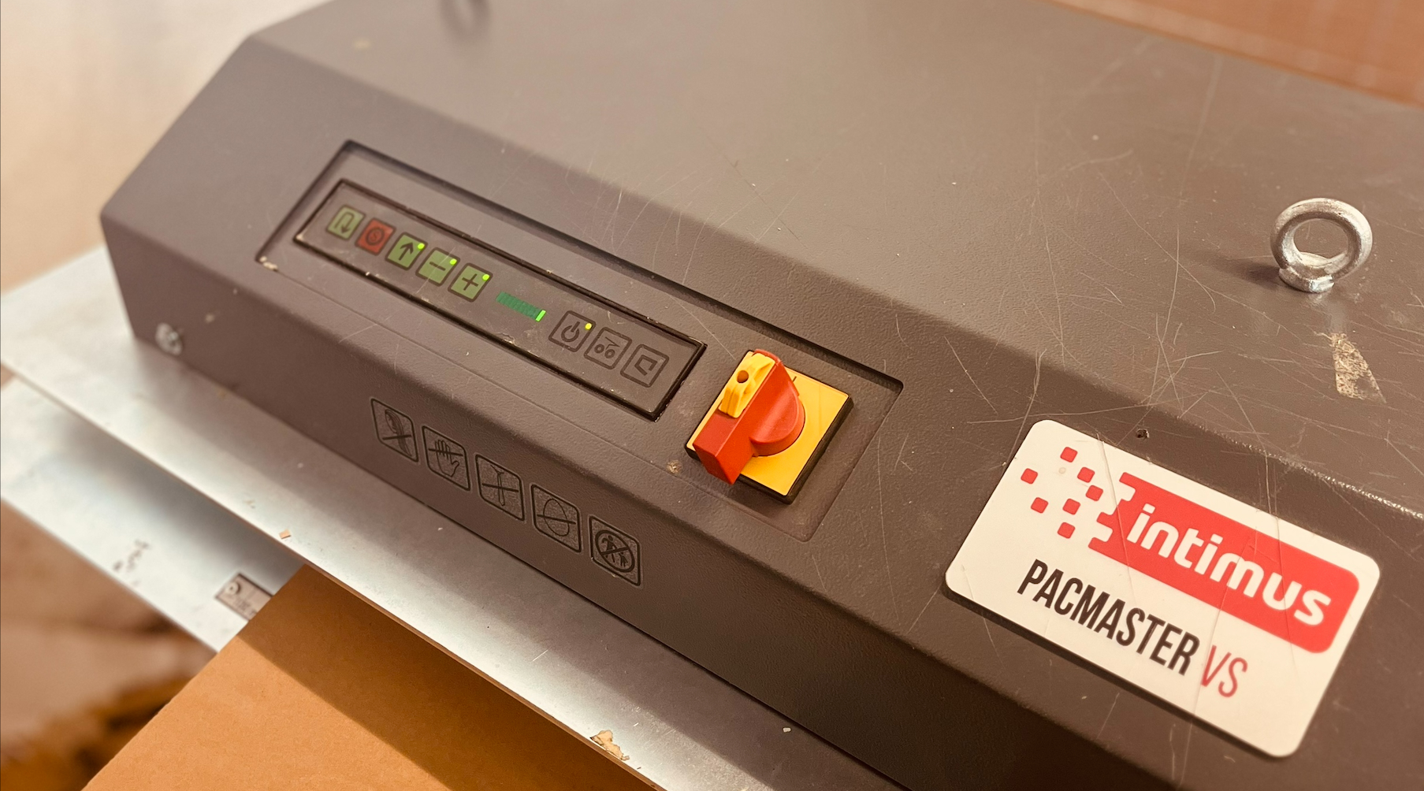
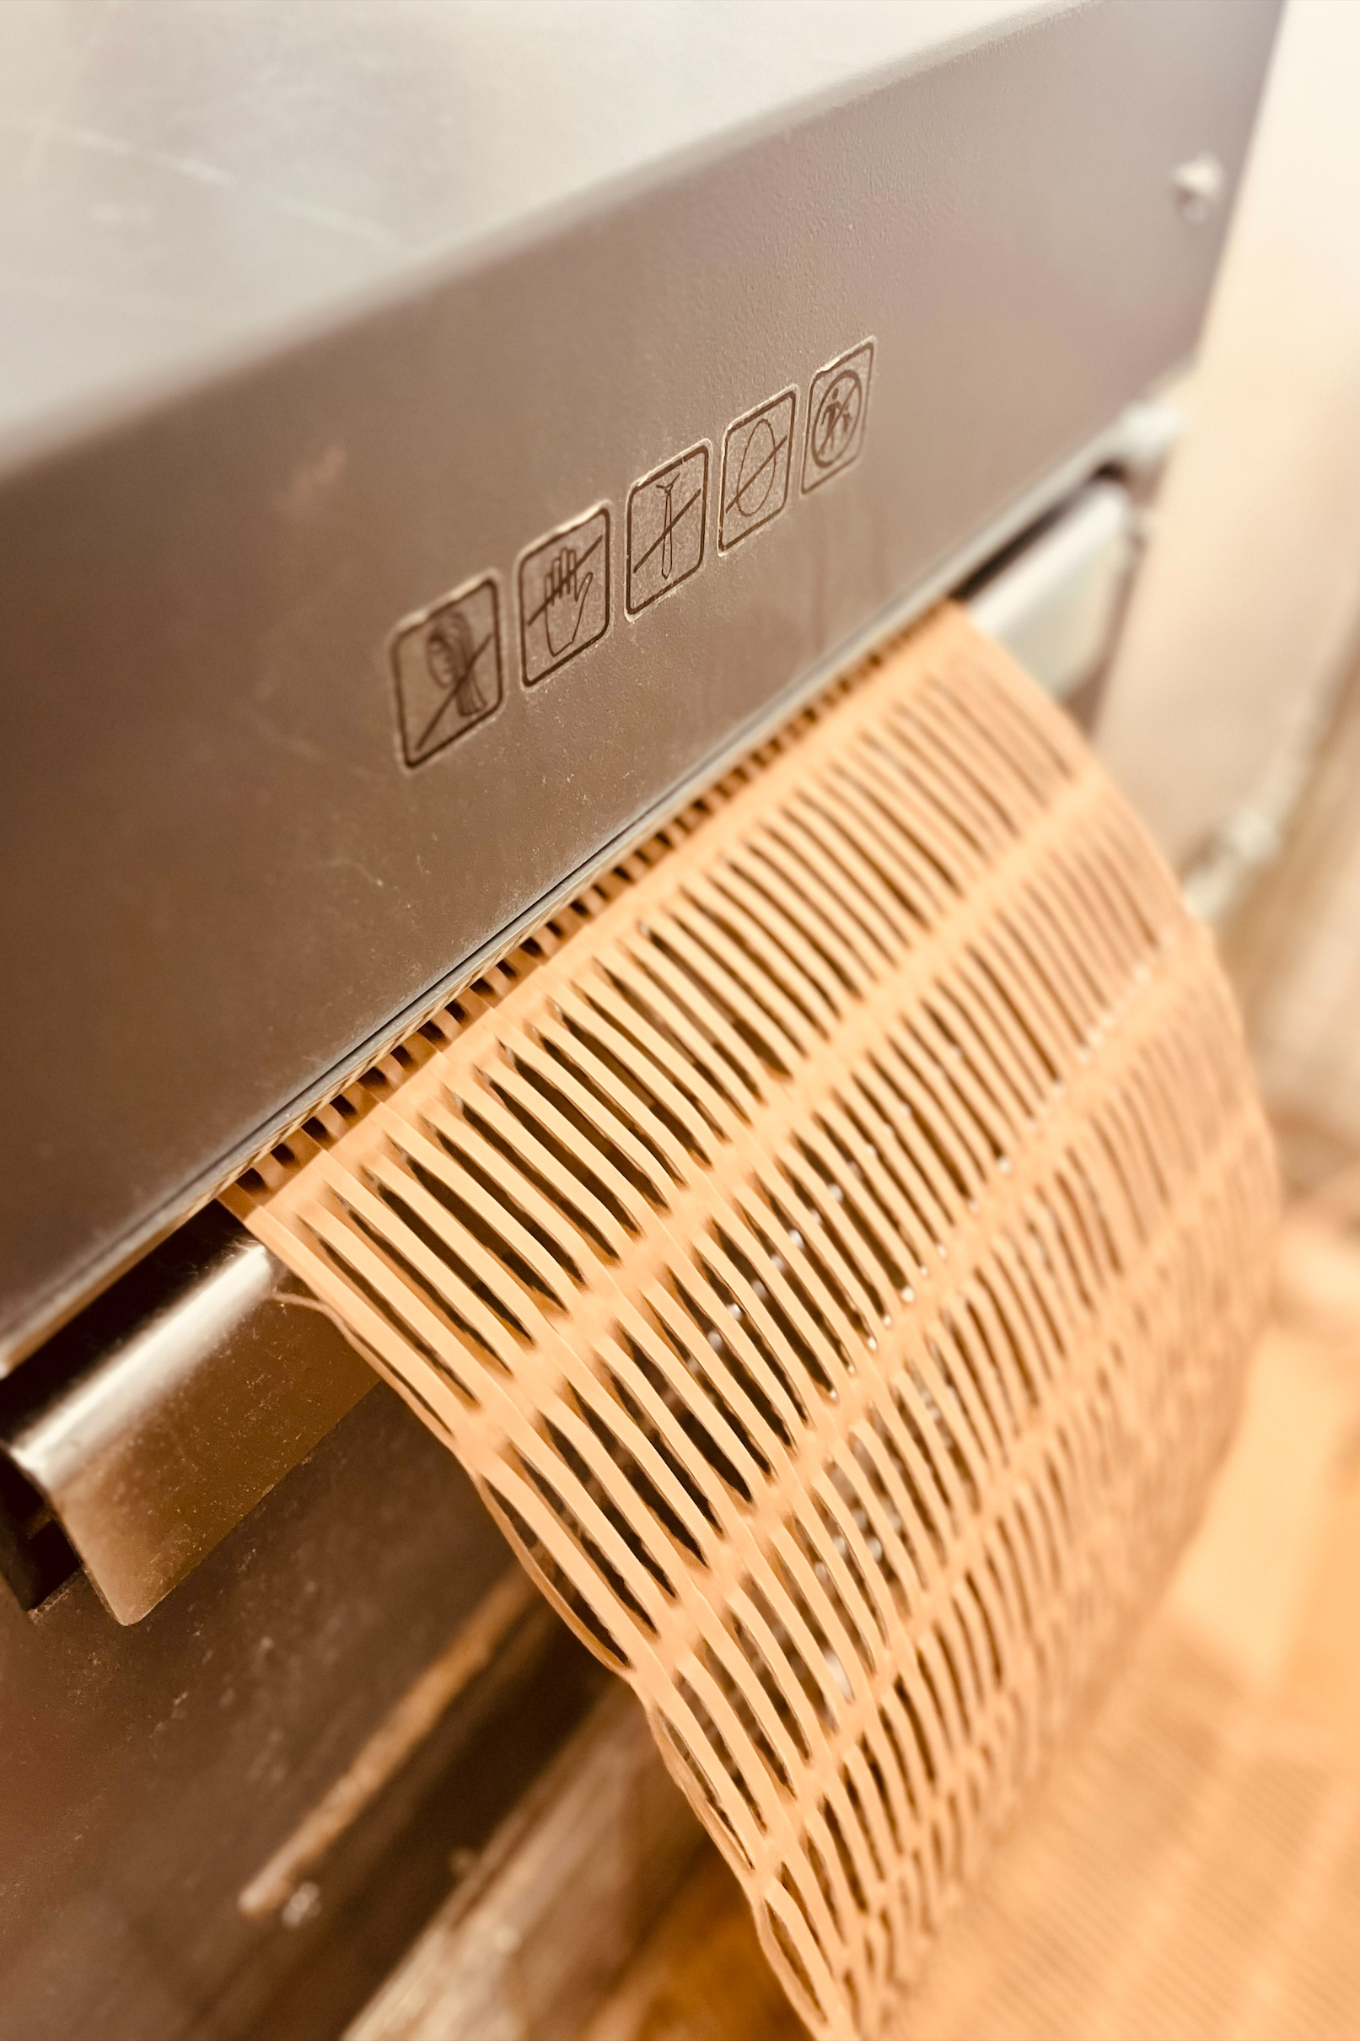


On-site Carton Shredding (AT)
Incoming boxes were discarded and new packages filled with new filler paper. Now incoming carton boxes are shredded and used as filler.
Pilot period: Feb 01, 2026 – Jan 31, 2027
1
2
3
4
5
Collection of cartons
Choice and weighing
Shredding
Use recycled filler
Evaluation (external purchases, staff occupation etc.)
INNOVATION
The experimental aspect lies in testing how such internal recycling can be operationally integrated into daily logistics routines, quantified in terms of cost, waste and CO₂ reduction, and scaled to other fulfilment centres.
Waste Reduction
CO₂ Emission Reduction
Material Cost Saving
Avoided Disposal Fees
Process Feasibility and Scalability
Knowledge Transfer
EXPECTED RESULTS
ECONOMIC - saving in filler purchase cost
Carton shredder machine
ECOLOGIC - reduction of carton waste volume / weight
SOCIAL – Stable workflow is quickly established—no customization required
LogPOINT Operational management of the entire packaging process
ECONSULT Compile and compare all recorded data with baseline values
KEY PERFORMANCE INDICATORS
Financial share of new packaging material
Shredder output
Customer satisfac-tion (%)
Customer satisfac-tion
(Score)
Share of recycled material
CO2 avoidance – packaging
Packaging cost per delivery
Measured:
once
periodically
SCENARIO IMPACT MATRIX
Logistics Consolidation
Transport Mode Shift
Consumer Behaviour Change
Resource Efficiency / Preservation
Scenario Impact
x
x
x
x
Funded by the European Union under grant agreement No 101147942. Views and opinions expressed are however those of the author(s) only and do not necessarily reflect those of the European Union or European Climate, Infrastructure and Environment Executive Agency (CINEA). Neither the European Union nor the granting authority can be held responsible for them.

