Slide 1
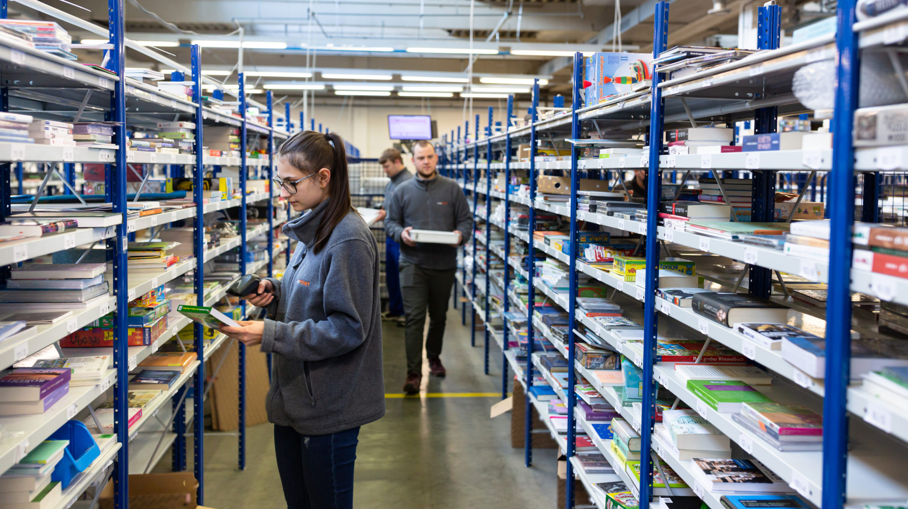
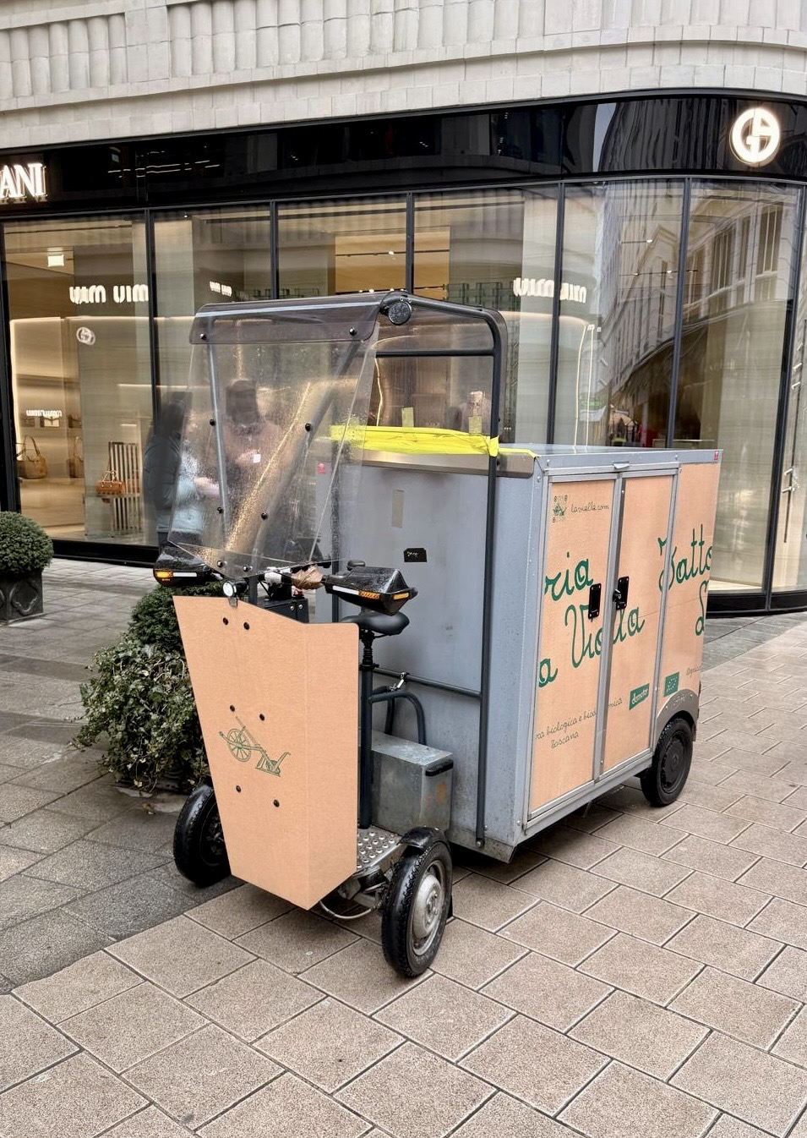


ZE deliveries of biologically produced food (AT)
All parcels were handed over to AT Post producing some CO2 in transport. In the test the parcels for Vienna are sorted out and delivered 100% CO2 free with cargo bikes.
Pilot period: Feb 1, 2026 – Jan 31, 2027
1
2
3
4
5
Identify parcels
Transfer data and parcels
Plan and assign delivery routes
Load scooters and deliver
Confirm completed delivery
INNOVATION
This approach enables the efficient use of electric scooters for multiple customers within one delivery area. The integration of micro-distribution logistics into a regional fulfilment hub represents an innovative and scalable model for sustainable e-commerce operations.
OBJECTIVES
CO₂ emission reduction
Operational efficiency
Digital integration
Economic feasibility
Scalability and Replicability
EXPECTED RESULTS
TECHNOLOGIES/TOOLS INVOLVED
ECONOMIC - Comparable or slightly lower delivery cost per parcel; no increase in total logistics cost
Software: API connection
Transport vehicle: Cargo Scooter.
ECOLOGIC - Reduction of direct CO₂ emission
Zero tailpipe emissions
SOCIAL - Reliable daily operation of e-scooter deliveries; further automized digital data ex-change with less manual correction needs.
ORGANIZATIONS INVOLVED
LogPOINT Fulfilment hub operator coordinating parcel preparation, data exchange and pilot monitoring
La Vialla and other bio-food suppliers
Veloce Bicycle courier service for transport
ECONSULT Data analysis
KEY PERFORMANCE INDICATORS
VKT per delivery/ return
Avg. load factor at tour start by vehicle type
Share of deliveries by non-fossil fuel vehicles
Emissions per km per vehicle type
Customer satisfac-tion (%)
Avg. stops per tour
Cost per delivery/
return
Emissions per delivery
Share of non-fossil fuel vehicles in the fleet
Customer satisfac-tion
(Score)
Measured:
once
periodically
SCENARIO IMPACT MATRIX
Logistics Consolidation
Transport Mode Shift
Consumer Behaviour Change
Resource Efficiency / Preservation
Scenario Impact
x
x
x
x
Funded by the European Union under grant agreement No 101147942. Views and opinions expressed are however those of the author(s) only and do not necessarily reflect those of the European Union or European Climate, Infrastructure and Environment Executive Agency (CINEA). Neither the European Union nor the granting authority can be held responsible for them.

